Slide 1
DevOpsSec
Continuous Delivery

Slide 2
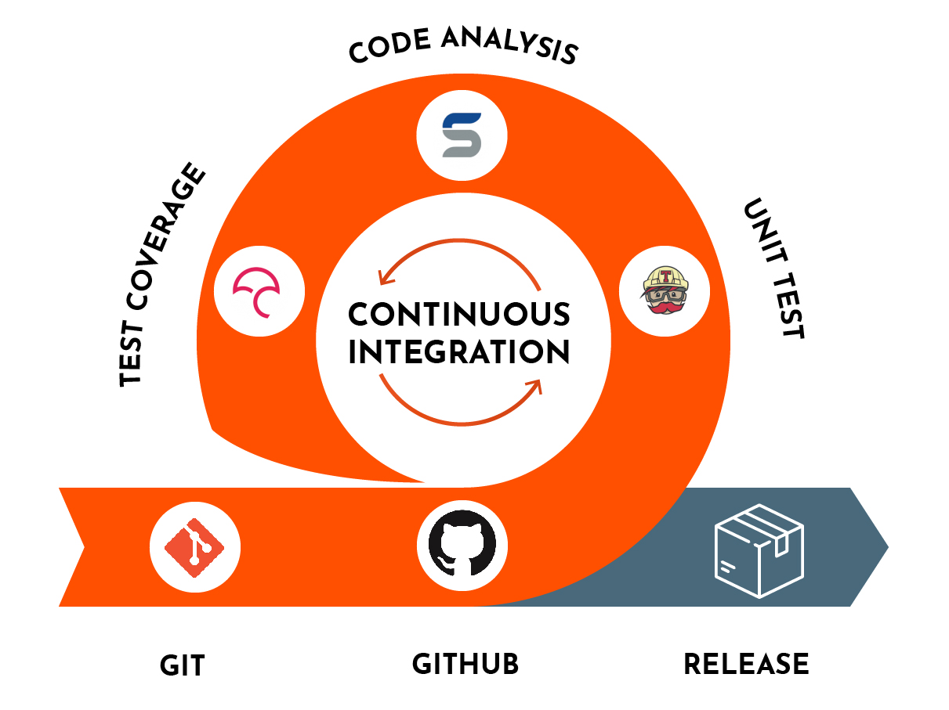
Continuous Integration
Continuous integration (CI) is a software development practice in which developers merge their changes to the main branch many times per day. Each merge triggers an automated code build and test sequence, which ideally runs in less than 10 minutes. A successful CI build may lead to further stages of continuous delivery.
If a build fails, the CI system blocks it from progressing to further stages. The team receives a report and repairs the build quickly, typically within minutes.
All competitive technology companies today practice continuous integration. By working in small iterations, the software development process becomes predictable and reliable. Developers can iteratively build new features.
Product managers can bring the right products to market, faster. Developers can fix bugs quickly and usually discover them before they even reach users.
Continuous integration requires all developers who work on a project to commit to it. Results need to be transparently available to all team members and build status reported to developers when they are changing the code. In case the main code branch fails to build or pass tests, an alert usually goes out to the entire development team who should take immediate action to get it back to a “green” state.
https://devonblog.com/wp-content/uploads/2019/07/c-i-100.jpg

Slide 3
Continuous Delivery
Continuous delivery is a software engineering practice in which code changes are prepared to be released to production. However, keep in mind that the codes must pass the automated unit testing, integration testing, system testing before being pushed to production.

Slide 4
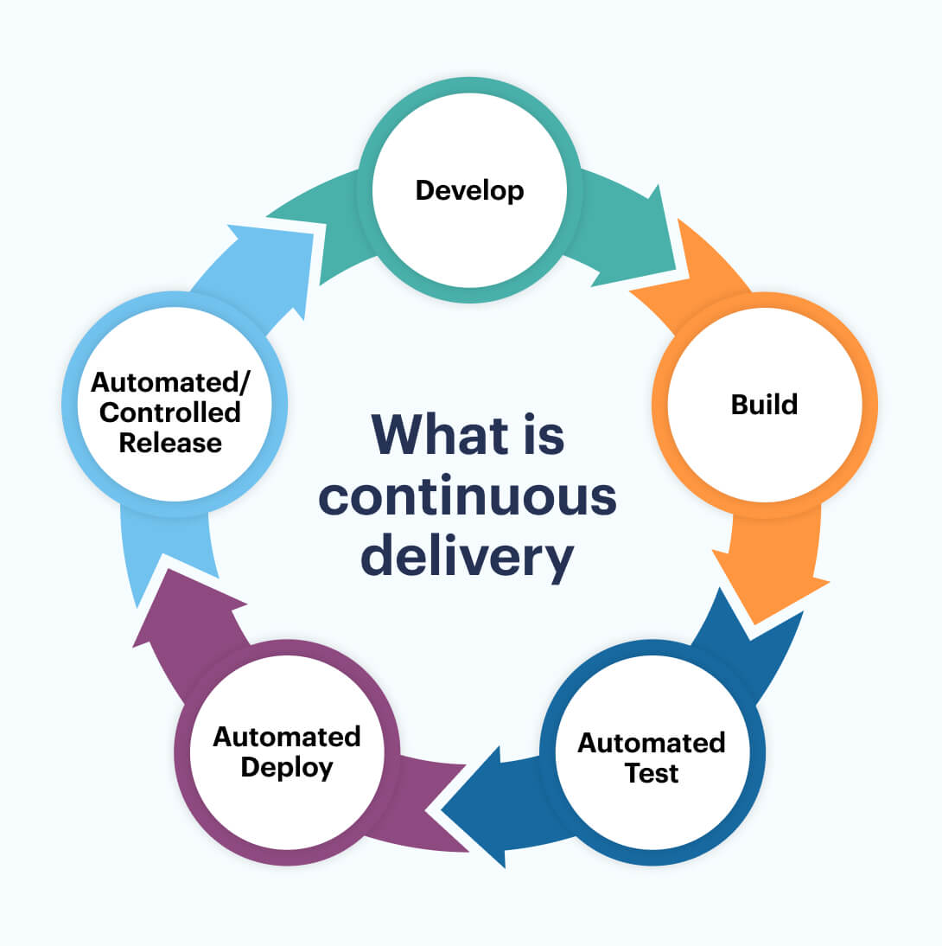
Continuous Delivery
A software engineering practice that involves preparing code changes for production deployment.
Makes complete surety on frequent releases.
Assures that releases are concluded into smaller parts.
Permits for immediate reactions to flaws.
Improves the stability, dependability, and controllability of releases.
Organizations that seek to roll out new features and releases regularly.
The deployment must be automated using continuous delivery methods.
Test automation is used to determine whether or not the software fits the exit criteria

Slide 5
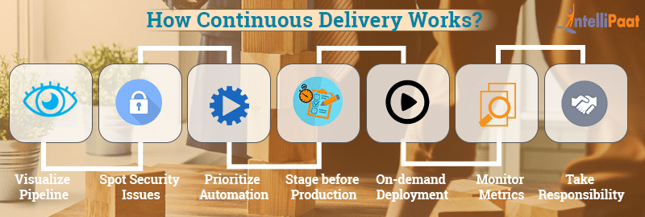
How to make Continuous Delivery a success?

Slide 6
What Continuous Delivery Does and Doesn't Do
Continuous delivery automatically deploys releases to a testing or staging environment.
Continuous delivery does not automatically deploy code changes to production.
Continuous delivery does require human intervention to deploy a release from staging to production.

Slide 7
Continuous Delivery Pipeline
A continuous delivery pipeline is a structured, automated process that typically starts with a developer who commits new code to a repository.
Continuous delivery pipeline is the process of building, testing and deploying software in shorter cycles.
The delivery pipeline breaks down the software delivery process into different stages. Each stage verifies quality of new features and validates functionalities to prevent errors that may affect users.
The new build is subjected to automated tests, might be deployed to a staging environment for additional testing, and can then be deployed to production with the push of a button.

Slide 8
How Continuous Delivery Pipeline works?
A continuous delivery pipeline consists of five main phases—
1. build/develop,
2. commit,
3. test,
4. stage, and
5. deploy.

Slide 9
Continuous Delivery Pipeline ‘Build / Develop’ phase
A build/develop process performs the following:
Pulls source code from a public or private repository.
Establishes links to relevant modules, dependencies, and libraries.
Builds (compiles) all components into a binary artifact.

Slide 10
Continuous Delivery Pipeline ‘Commit’ phase
The commit phase checks and sends the latest source code changes to the repository.
Commit tasks typically run as a set of jobs, including:
Compile the source code
Run the relevant commit tests
Create binaries for later phases
Perform code analysis to verify health
Prepare artifacts like test databases for later phases

Slide 11
Continuous Delivery Pipeline ‘Test’ phase
During the test phase, the completed build undergoes comprehensive dynamic testing.
It occurs after the source code has undergone static testing.
Dynamic tests commonly include:
Unit or functional testing—helps verify new features and functions work as intended.
Regression testing—helps ensure new additions and changes do not break previously working features.
Additionally, the build may include a battery of tests for user acceptance, performance, and integration.

Slide 12
Continuous Delivery Pipeline ‘Stage’ phase
The staging phase involves extensive testing for all code changes to verify they work as intended, using a staging environment, a replica of the production (live) environment.
It is the last phase before deploying changes to the live environment.
The staging environment mimics the real production setting, including hardware, software, configuration, architecture, and scale
The goal is to verify all assumptions made before development and ensure the success of your deployment.
It also helps reduce the risk of errors that may affect end users, allowing you to fix bugs, integration problems, and data quality and coding issues before going live.

Slide 13
Continuous Delivery Pipeline ‘Deploy’ phase
The deployment phase occurs after the build passes all testing and becomes a candidate for deployment in production.
A continuous delivery pipeline sends the candidate to human teams for approval and deployment.
A continuous deployment pipeline deploys the build automatically after it passes testing.
Deployment involves creating a deployment environment and moving the build to a deployment target
It also requires connecting to error reporting and ticketing tools.
These tools help identify unexpected errors post-deployment and alert developers, and allow users to submit bug tickets.

Slide 14
Principles of Continuous Delivery Pipeline
The process of releasing software must be repeatable and reliable: It means that we should release builds frequently, maintaining quality and security, and according to the client's demands.
Automate Everything: We should automate everything we do regularly and repeatedly. What can be described can be automated.
If something is difficult, painful, do it more often: It means that working on a project which lets us think is difficult, when we work on it, improve it, automate it, it feels comfortable.
Improve continuously: don't sit idle like let the system be outdated then we will work on it, we should continually work on it improve it, fix vulnerabilities, make it more secure reliable and less memory and time Consumption.

Slide 15
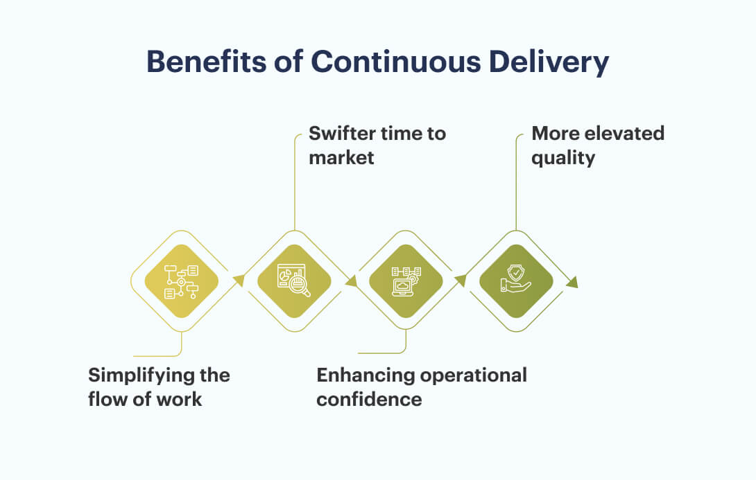

Slide 16
Continuous Deployment
Continuous deployment takes a further step from continuous delivery. It is a software engineering practice that ensures code changes are continuously released into the production environment. The goal is to release a new version whenever developers make changes and automatically get those changes to the end-users.

Slide 17
Continuous Deployment
Continuous deployment is a software engineering practice that ensures code changes are continuously released into the production environment. The goal is to release a new version whenever developers make changes and automatically get those changes to the end-users.

Slide 18
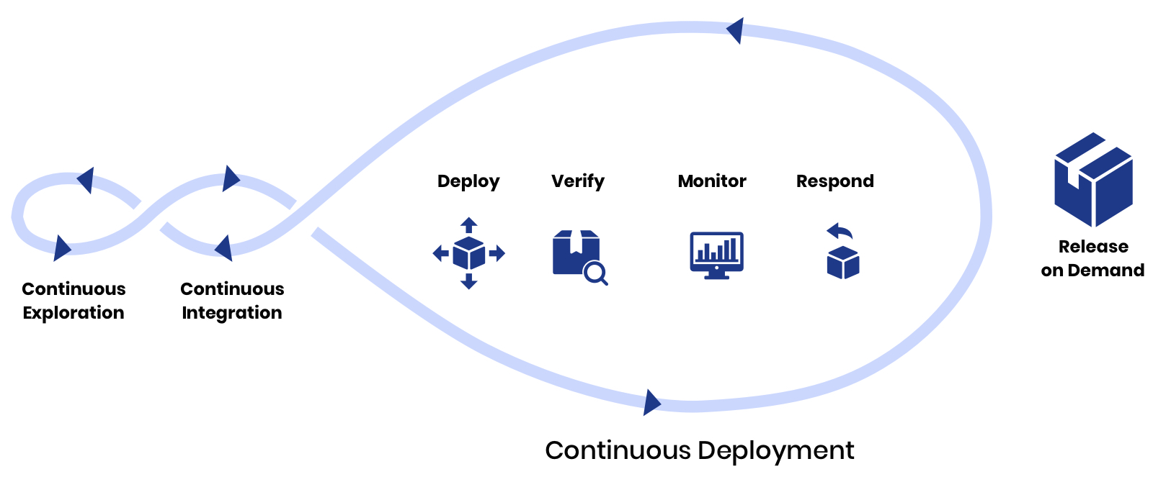
Continuous Deployment
Continuous deployment is a software development approach in which every code change goes through the entire pipeline and is put into production automatically, resulting in many production deployments every day
Continuous deployment takes CI a step further and automates the code release process so that each time new commits are merged into the mainline, automated testing is conducted, and passes results in pushing the update to the production environment.
The key to achieving continuous deployment is to start with a functioning workflow for continuous integration, then streamline and automate the application release process so you can roll out new releases regularly.
Continuous deployment adds an element of risk to the software release process, as developers frequently commit unproven code that could potentially contain bugs in the live environment

Slide 19
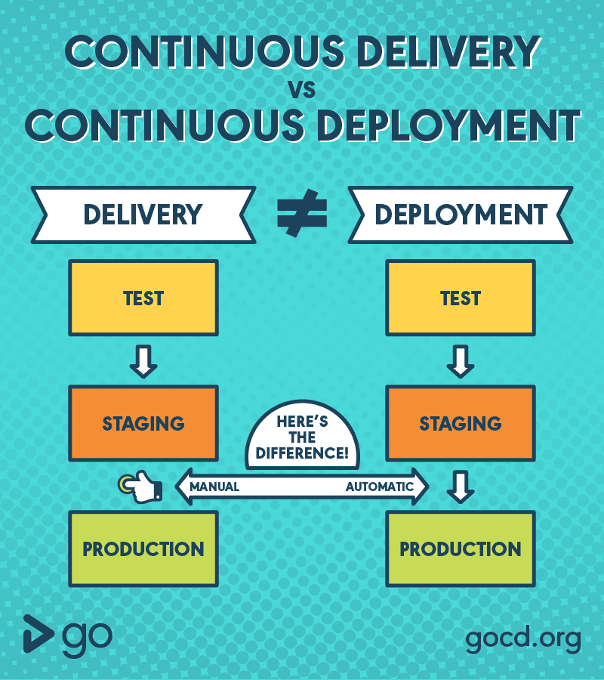
The main difference between continuous delivery and continuous deployment is simple: Continuous delivery automates deployment of a release to a staging or testing environment, while continuous deployment automatically deploys every release to production (after it passes through your pipeline, including testing).

Slide 20
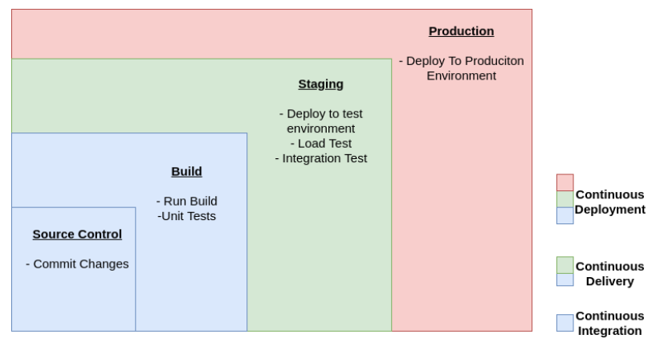

Slide 21
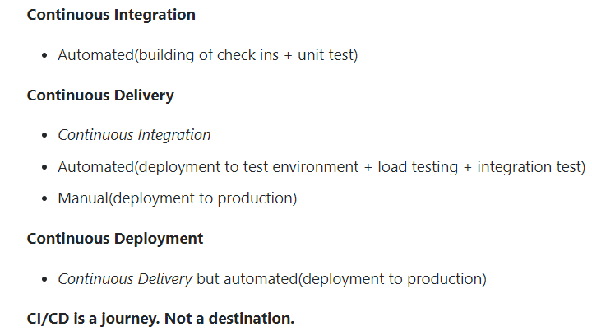

Slide 22
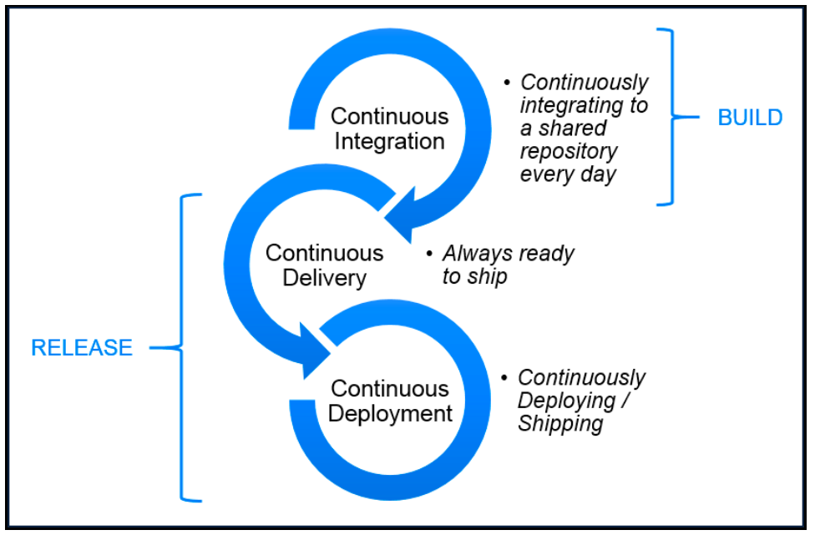

Slide 23
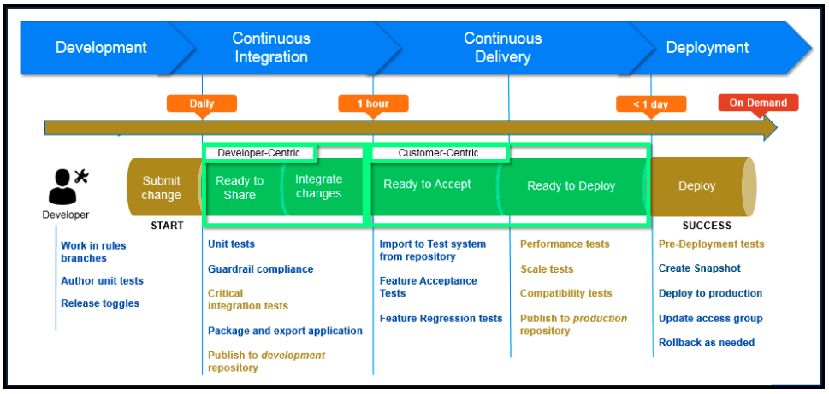
The Pega CI/CD pipeline

Slide 24
continuous integration VS continuous delivery VS continuous deployment
“
Continuous Integration (CI) is a software engineering practice in which developers integrate code into a shared repository several times a day in order to obtain rapid feedback of the feasibility of that code. CI enables automated build and testing so that teams can rapidly work on a single project together.
Continuous delivery (CD) is a software engineering practice in which teams develop, build, test, and release software in short cycles. It depends on automation at every stage so that cycles can be both quick and reliable.
Continuous Deployment is the process by which qualified changes in software code or architecture are deployed to production as soon as they are ready and without human intervention.

Slide 25
Quick summary and final thoughts
To sum up:
Continuous Integration (CI): short-lived feature branches, team is merging to master branch multiple times per day, fully automated build and test process which gives feedback within 10 minutes; deployment is manual.
Continuous Delivery (CD): CI + the entire software release process is automated, it may be composed of multiple stages, and deployment to production is manual.
Continuous Deployment: CI + CD + fully automated deployment to production.

Slide 26
Thanks!!

